Slide 1
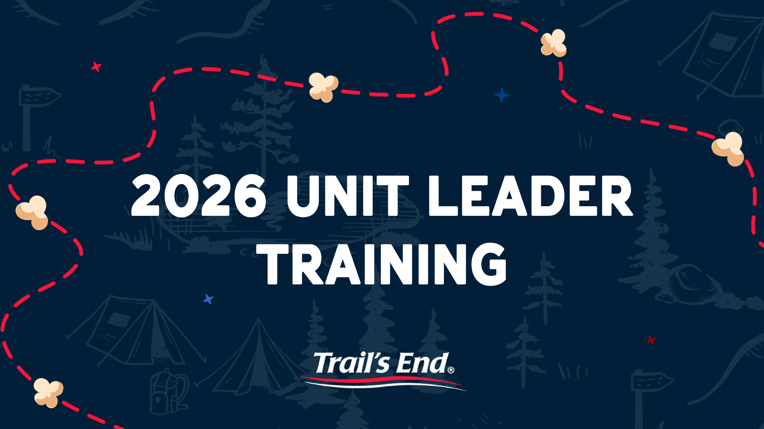


Slide 2



Slide 3
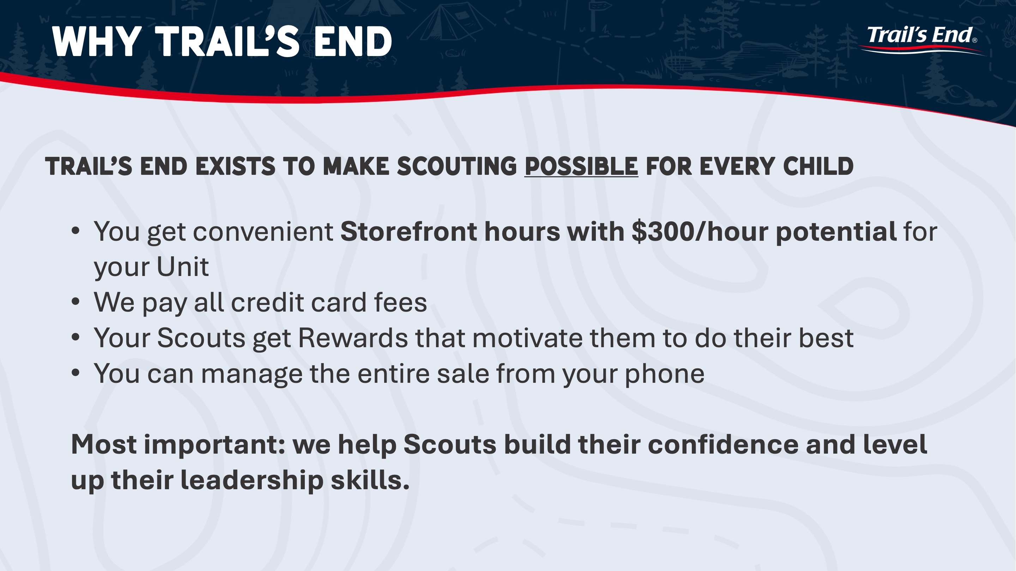

Slide 4
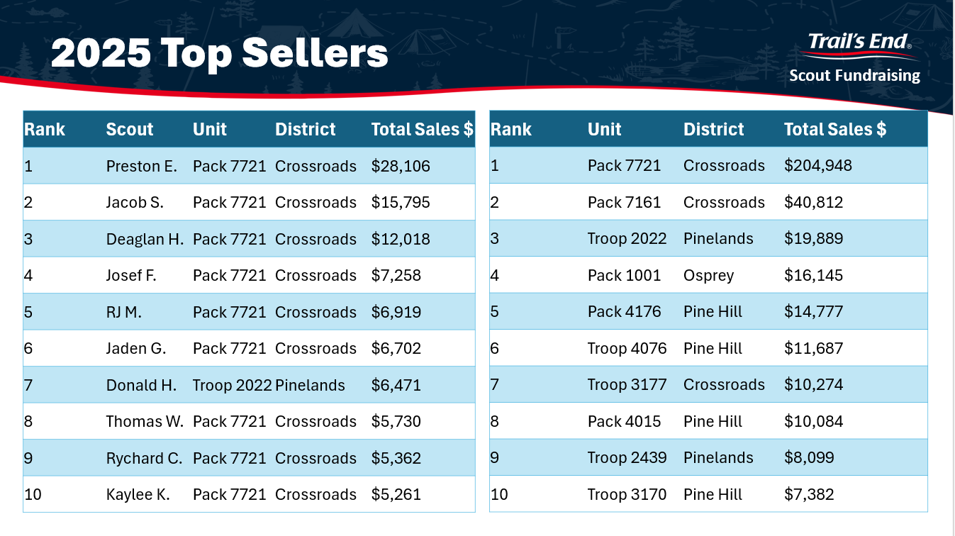

Slide 5
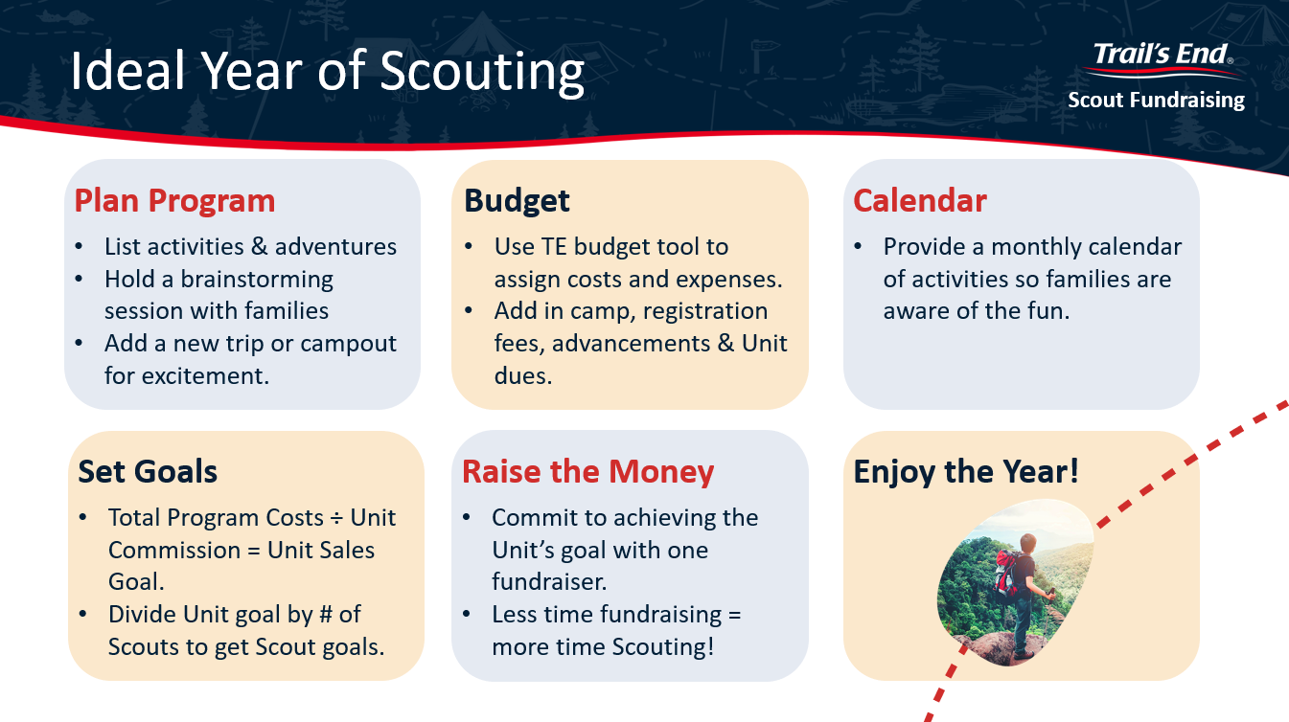

Slide 6
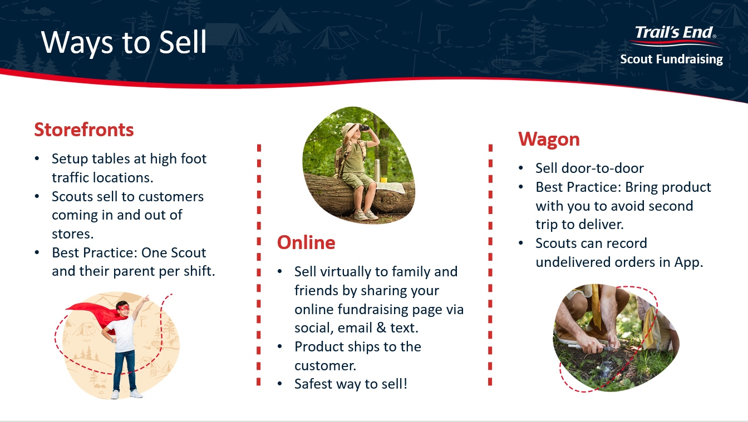

Slide 7
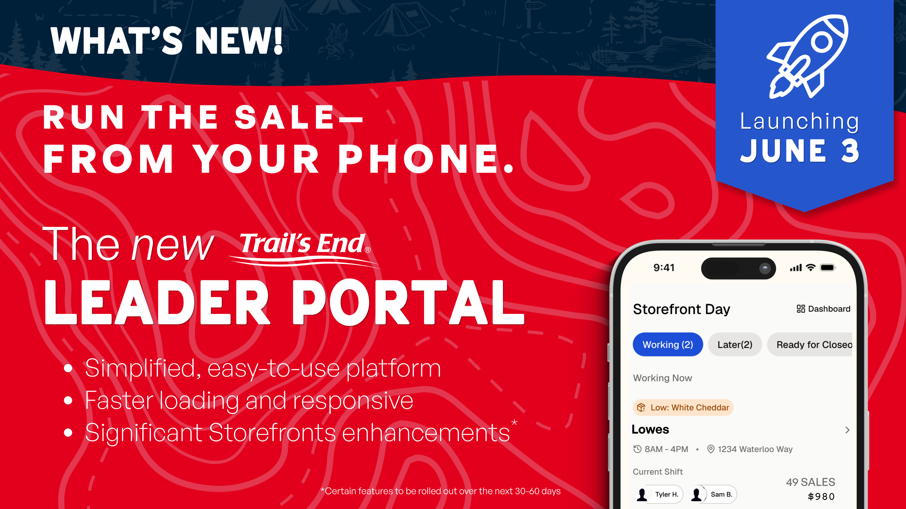

Slide 8
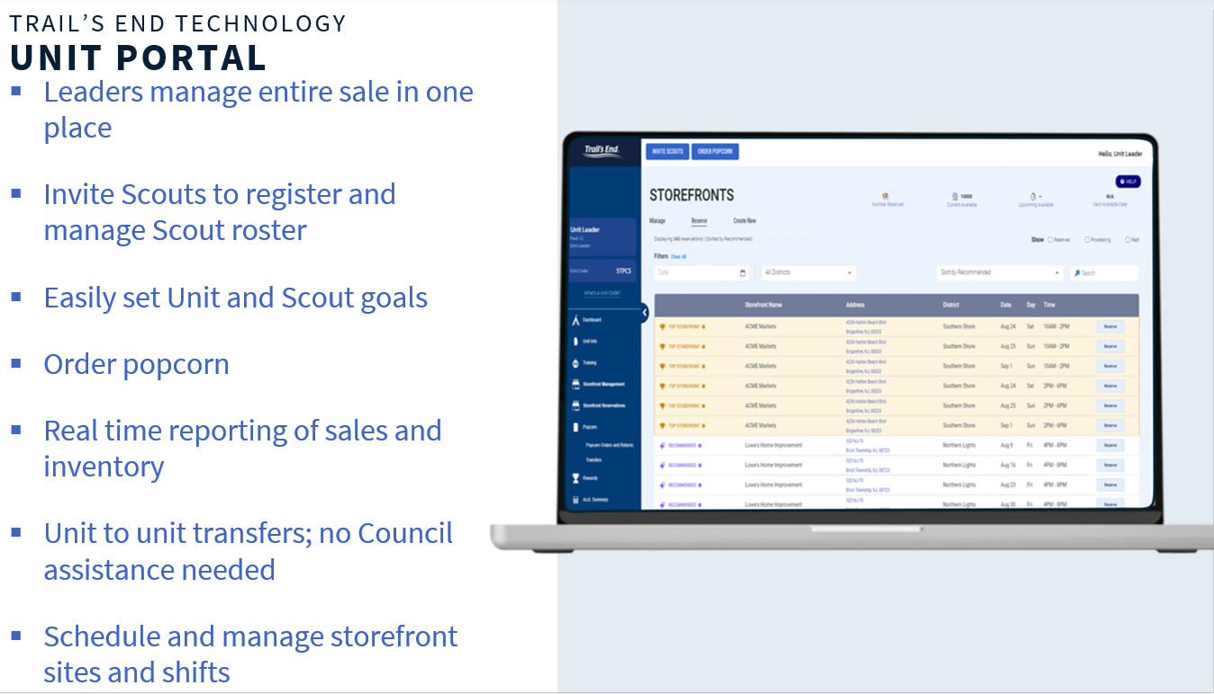

Slide 9
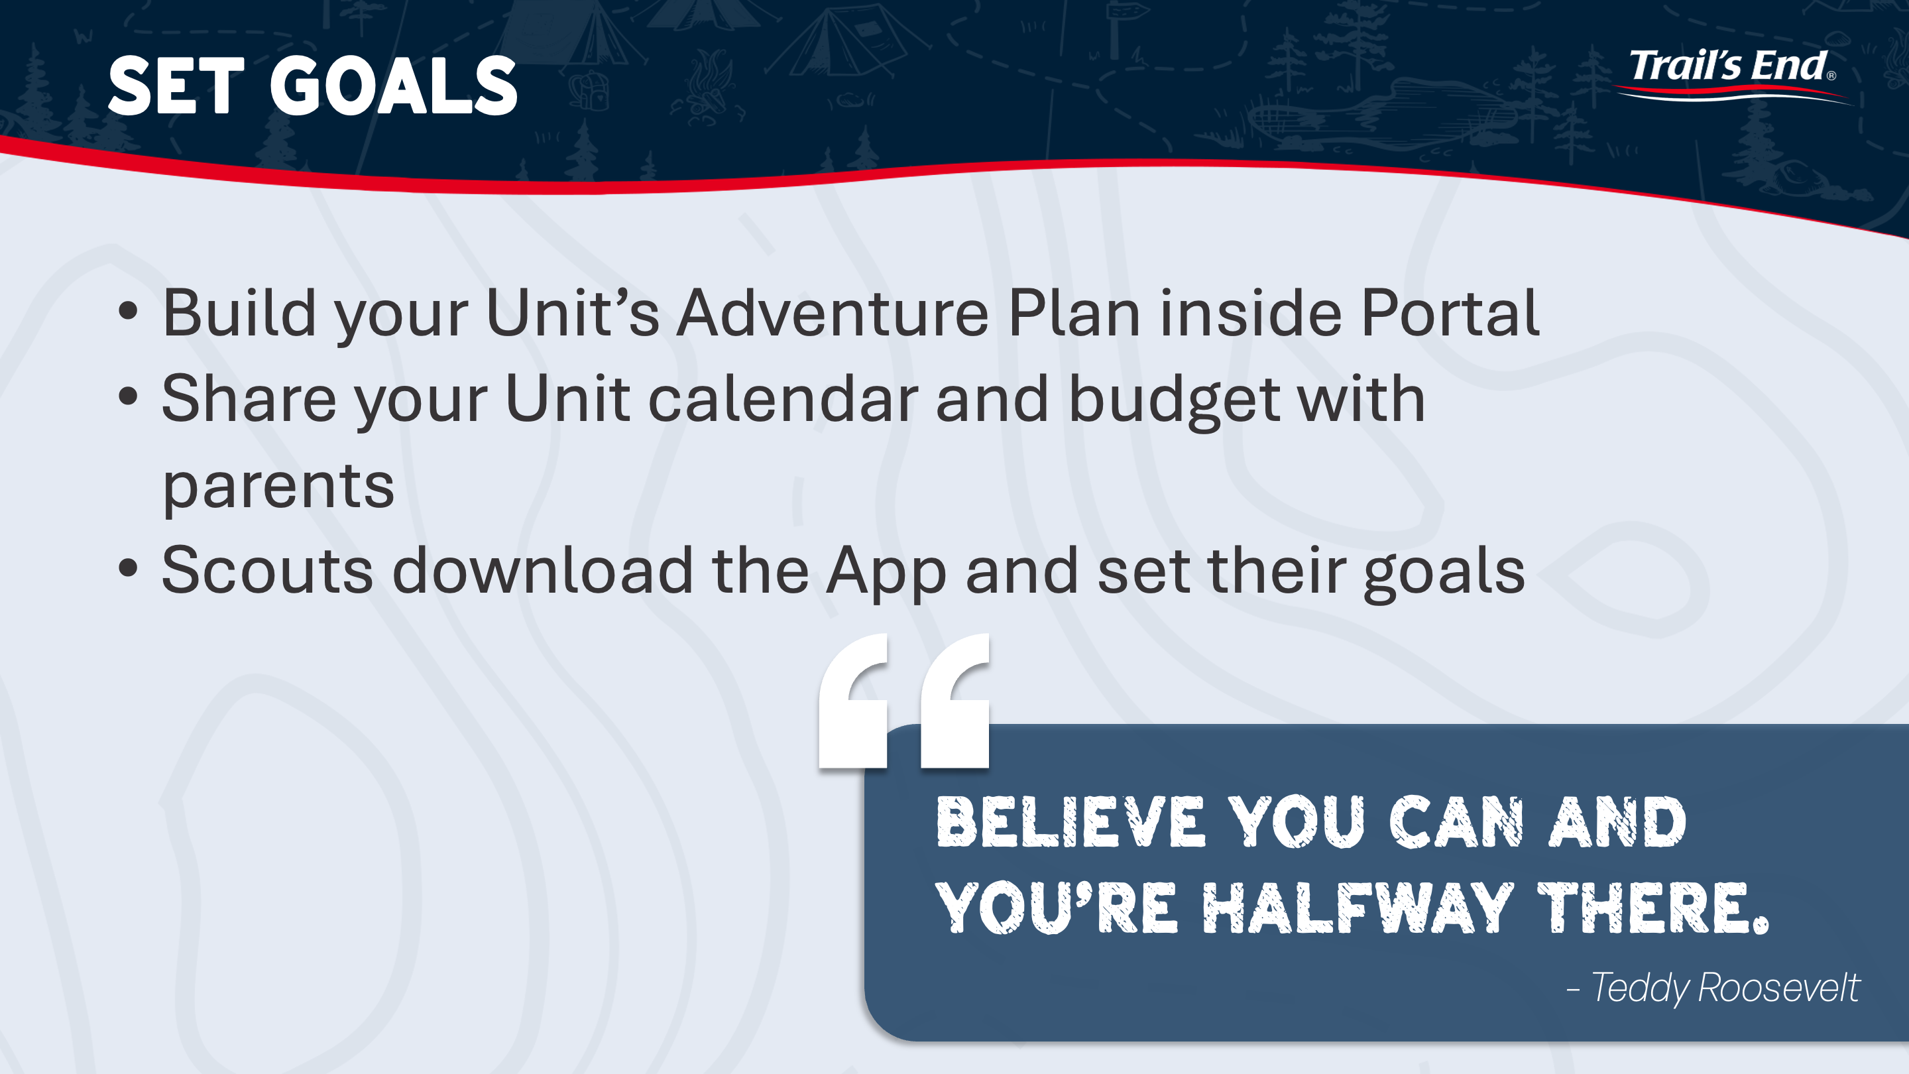

Slide 10
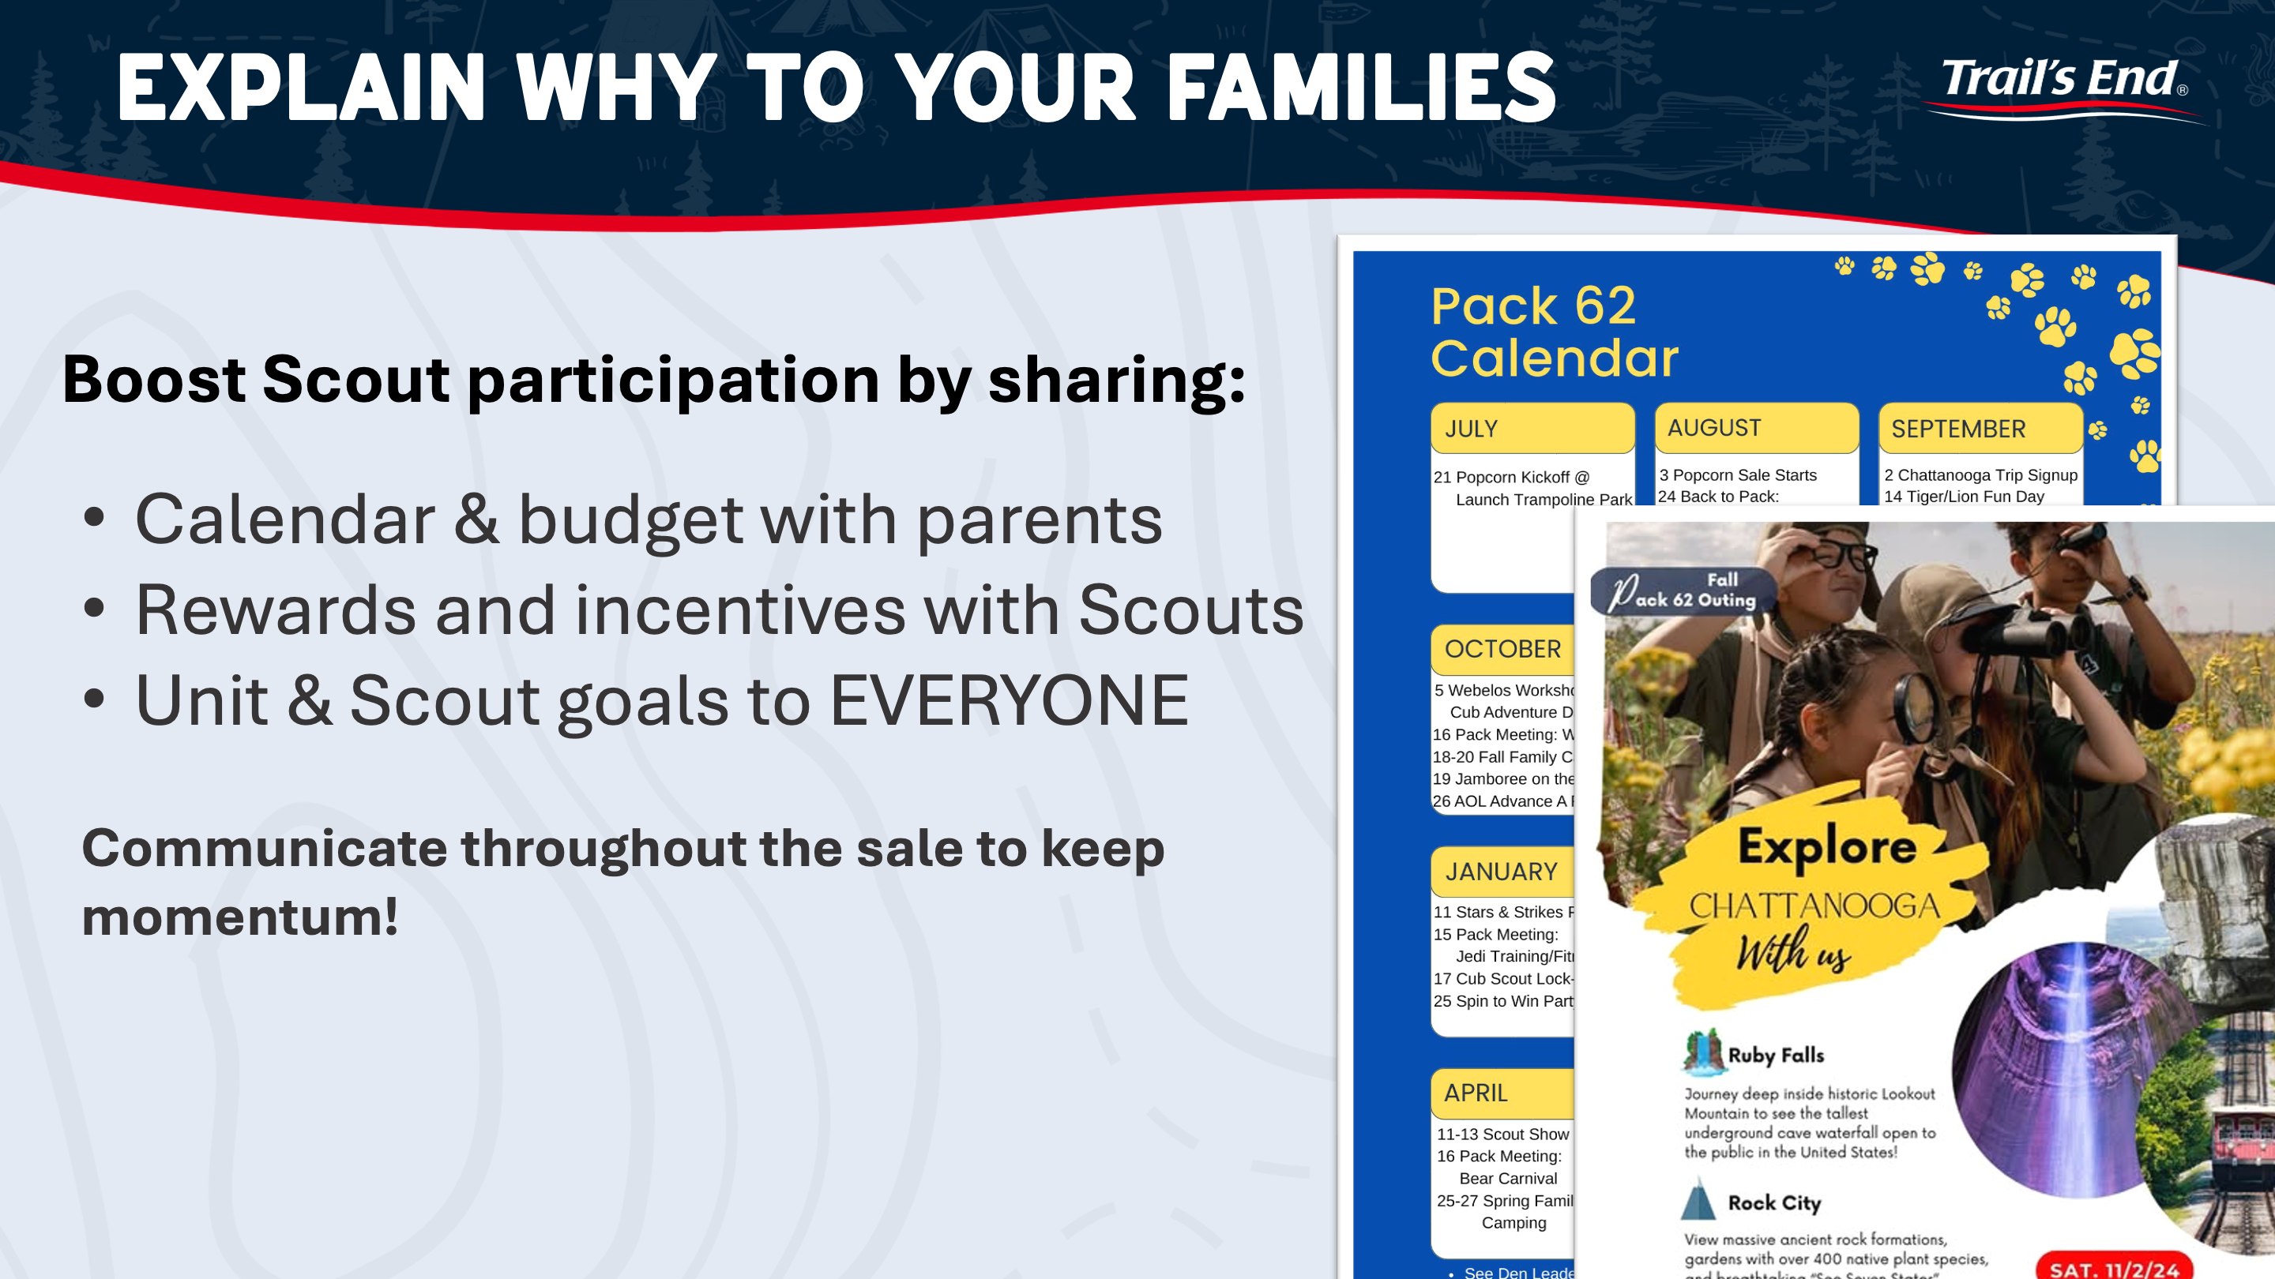

Slide 11
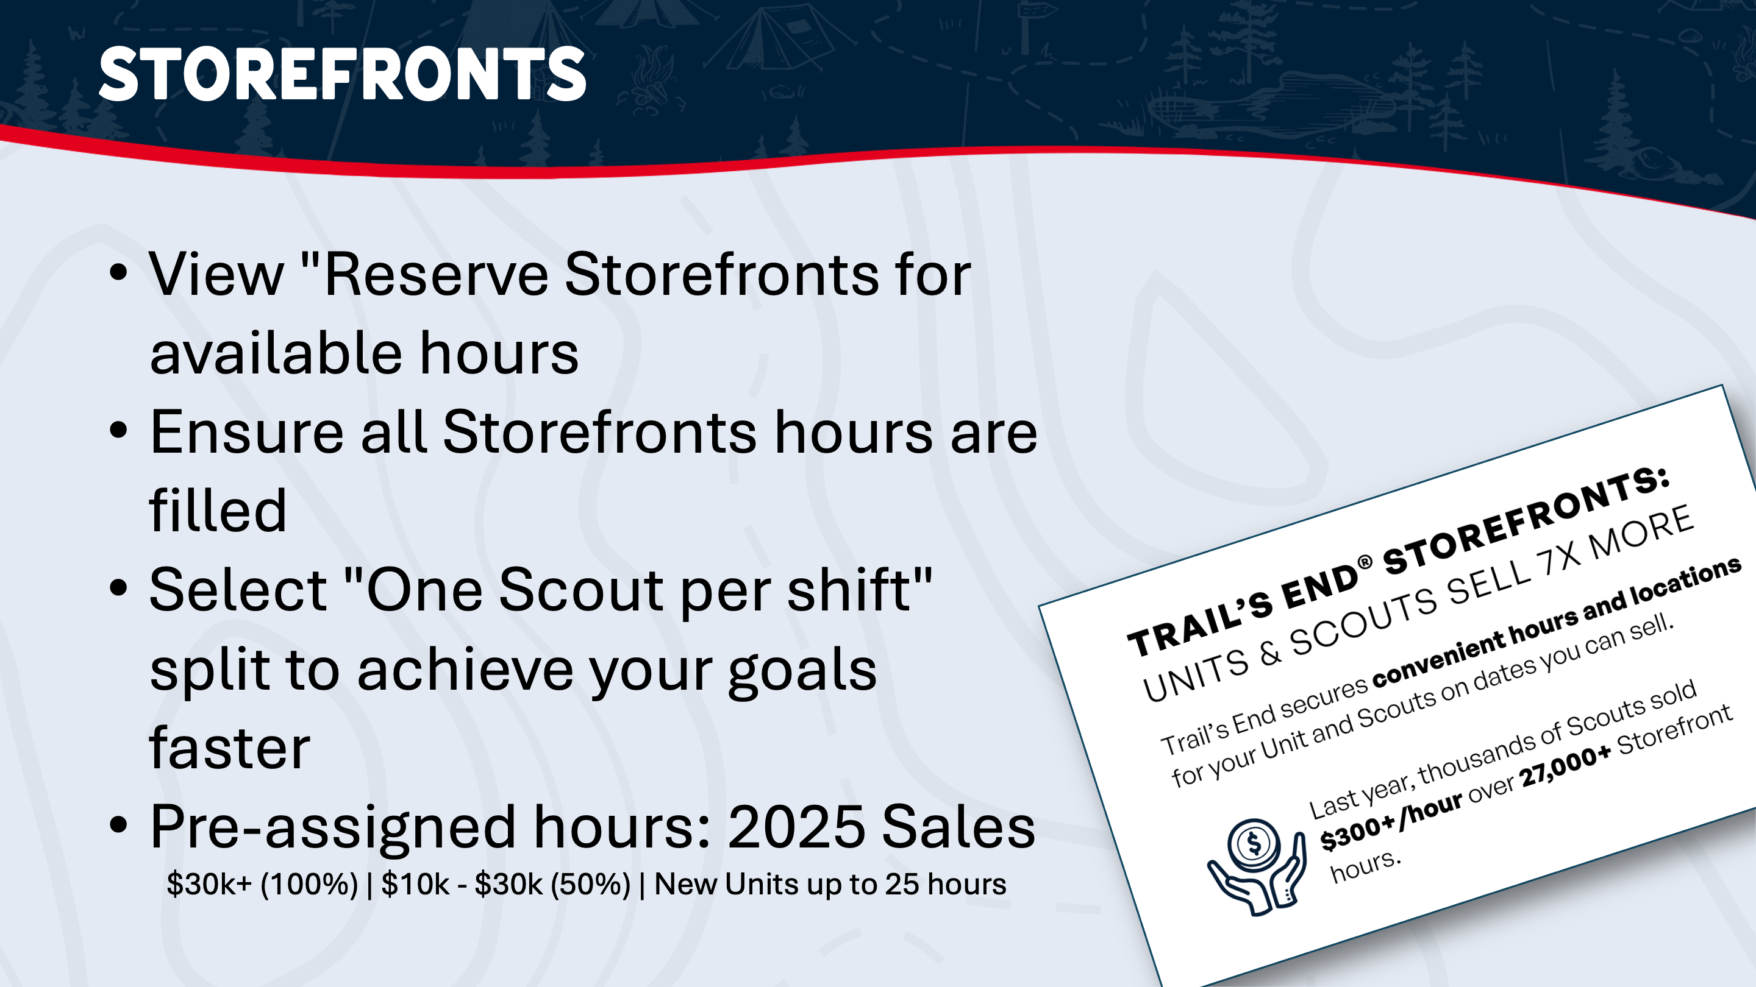

Slide 12
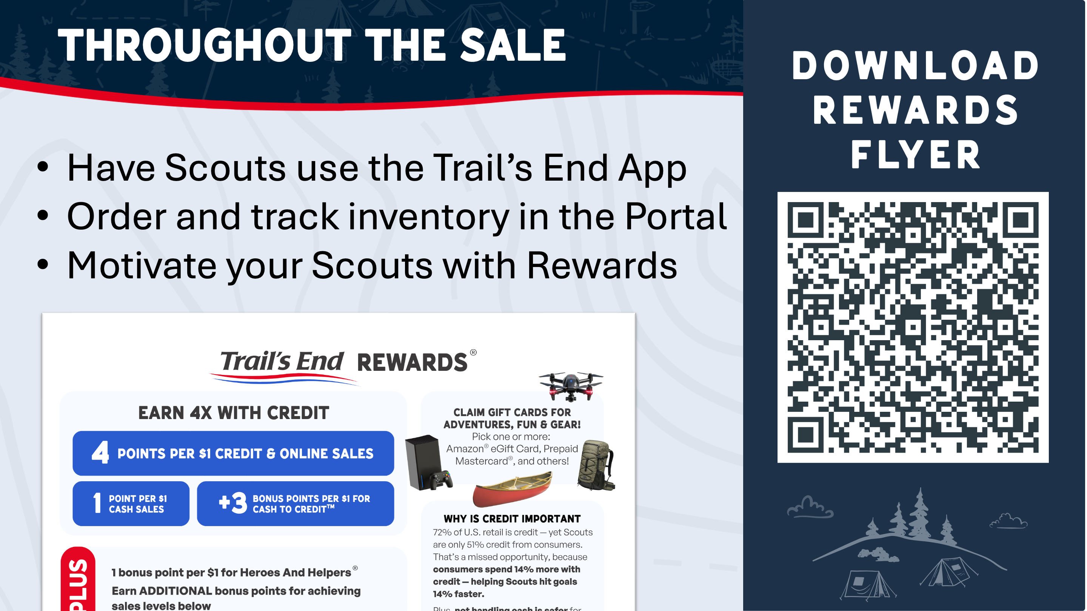

Slide 13
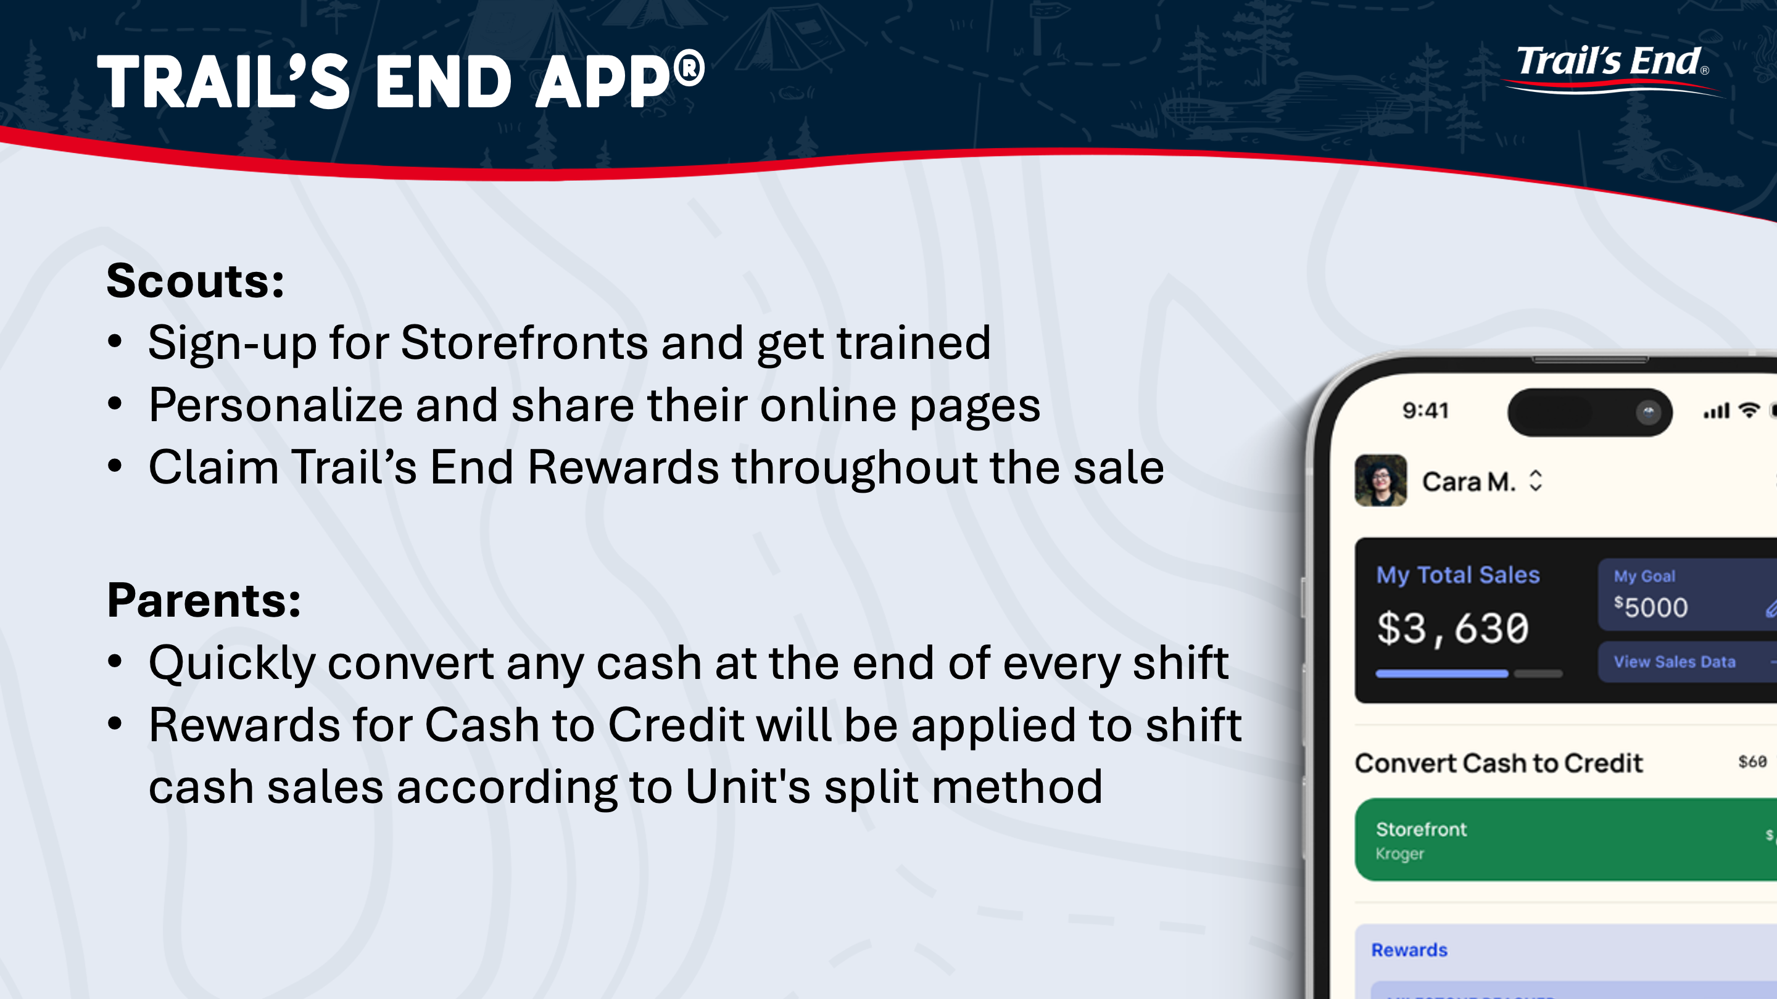

Slide 14
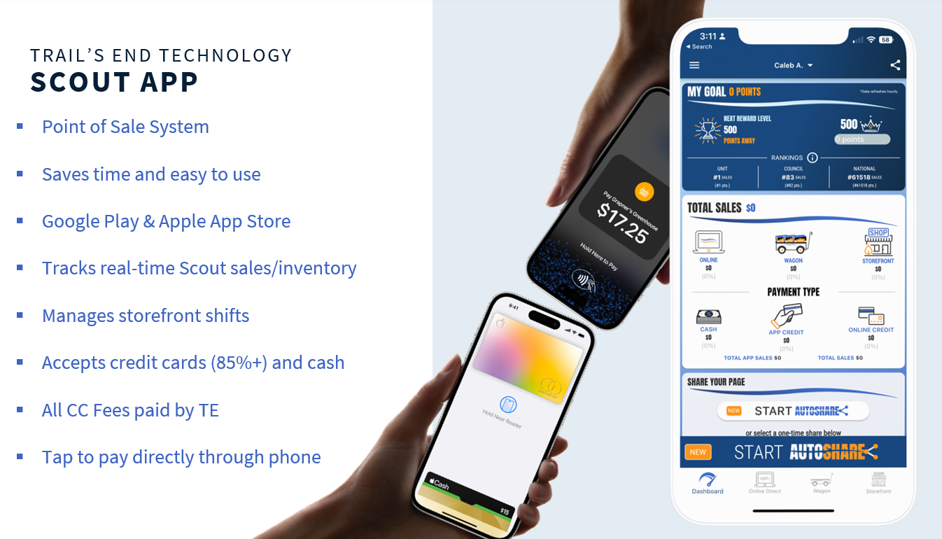

Slide 15
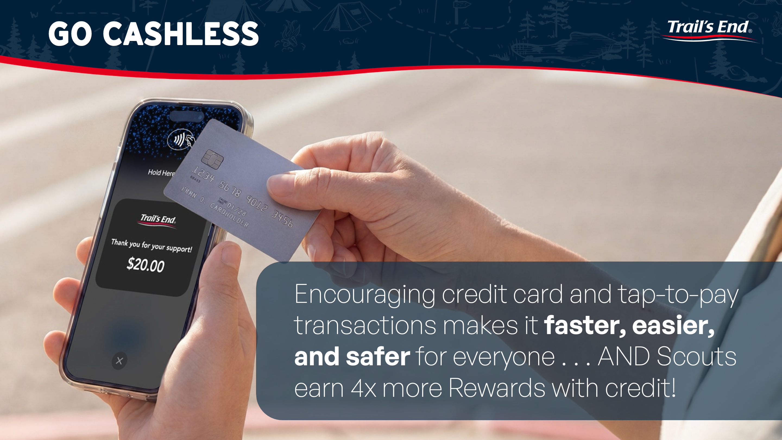

Slide 16
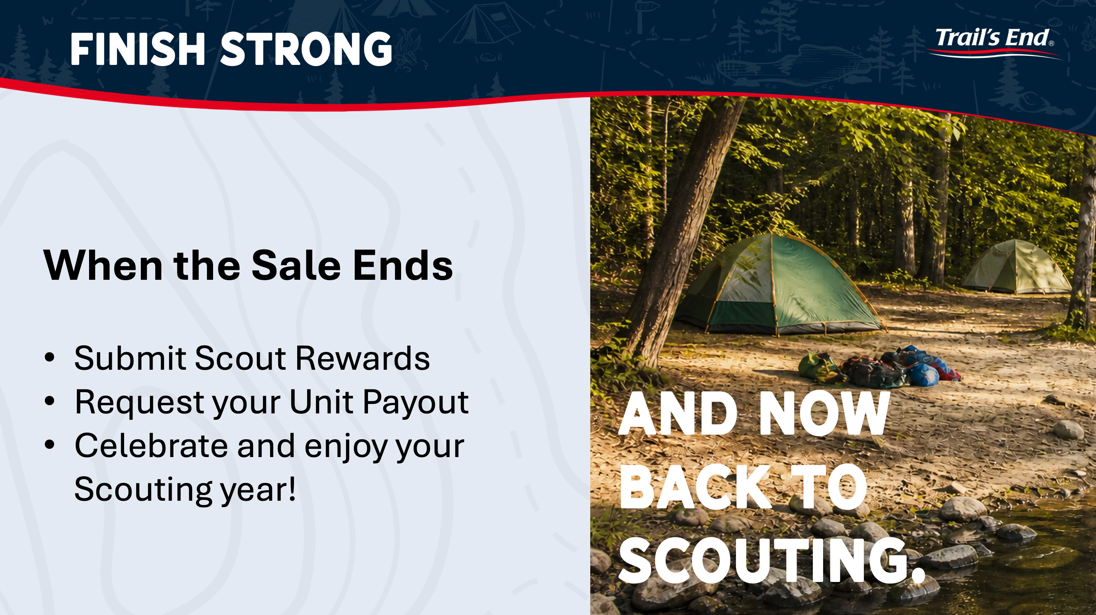

Slide 17
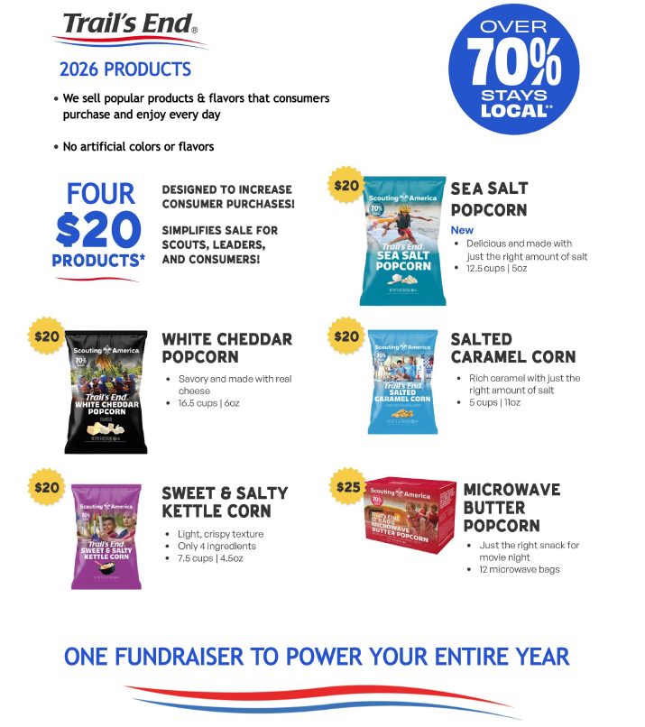
2026 Products
2026 Changes
No More Popping Corn Jar
NEW: Sea Salt Bag
Reminder: More Products available with Online Selling.

Slide 18
2026 Popcorn Dates
Popcorn Kickoffs - 5/28 and 6/2
Summer Sale Order Open – 6/22
Onboarding Due – 6/25
Summer Sale Unit Order Due – 7/6
Summer Sale Popcorn Pick Up – 7/17 (Council Office)
Show and Sell Order Open – 7/20
Show and Sell Order Due – 8/3
Show and Sell Popcorn Pick Up – 8/14 (Gray’s Trucking and Millville Scout Shop)
Show and Sell Popcorn Return Day – 9/18
Take Order Open – 10/19
Take Order Due – 11/2
Take Order Popcorn Pick Up – 11/13 (Council Office)

Slide 19
2026 Product Return Policy
Introducing a Garden State Council Popcorn Product Return Policy
Conditions of Product Returns:
1. Units would have to have convey their plan and request the necessary storefronts to Brian Domzalski or Jerry Bakanowsky before the campaign starts.
2. Units would be able to return unopened cases of Popcorn on
Friday, 9/18 from 9am to 5pm. (this roughly marks 1 month into the campaign)
Unit must communicate by Fri 9/11, that a return is coming.
3. Units would only be able to return up to 20% of total dollar amount taken from either the Summer Sale or Show and Sell Sale.

Slide 20
2026 Blitz Weekends
Blitz Weekend #1 – 8/22-8/23
Blitz Weekend #2 – 9/19-9/20
Blitz Weekend #3 – 10/17-10/18
Blitz Weekend
  For each of the above weekends, each Scout who participates in any part of the Popcorn Sale gets his or her name entered into a drawing.
  For each of the three weekends
    One winner from each District will receive a $50 Amazon Gift Card
    One grand prize Council winner will receive a $100 Amazon Gift Card

Slide 21
2026 Commission Structure
Base Commission – 33% (Storefront and Wagon Sales)
Bonus Commission – 2% (must attend a kickoff and onboard your unit by 6/25)
Online Commission – 35%
High Achieving Unit Commission
  Between $7,500 - $19,999 – 1%
  Between $20,000 - $29,999 – 2%
  Between $30,000 - $39,999 – 3%
  Between $40,000 - $49,999 – 4%
  Sales over $50,000 – 5%
  Total Commission Possible – 40%

Slide 22

Morey’s Piers and Water Parks – Popcorn Partner
$100,000 in Total Sales - Complimentary waterpark passes for all youth in the unit.
$25,000 in Total Sales – Complimentary waterpark passes for all youth in the unit, with the purchase of an adult ticket.
$15,000 in Total Sales – Complimentary pass for the Spring Beach Jam for all youth in the unit, with the purchase of an adult ticket.

Slide 23
Individual Scout Prize Levels
$500 or more – 2026 Popcorn patch
$1,250 or more – 2026 Top Seller’s Popcorn patch AND the invite to the Top Seller’s Event at Launch in Deptford in early 2027.
$3,500 or more – Popcorn Elite Top Seller’s Experience
Bonus Scout Prize
- Any Scout who increases their Popcorn Sales over 2025 by $1,000 or more, will receive a hiking backpack.

Slide 24
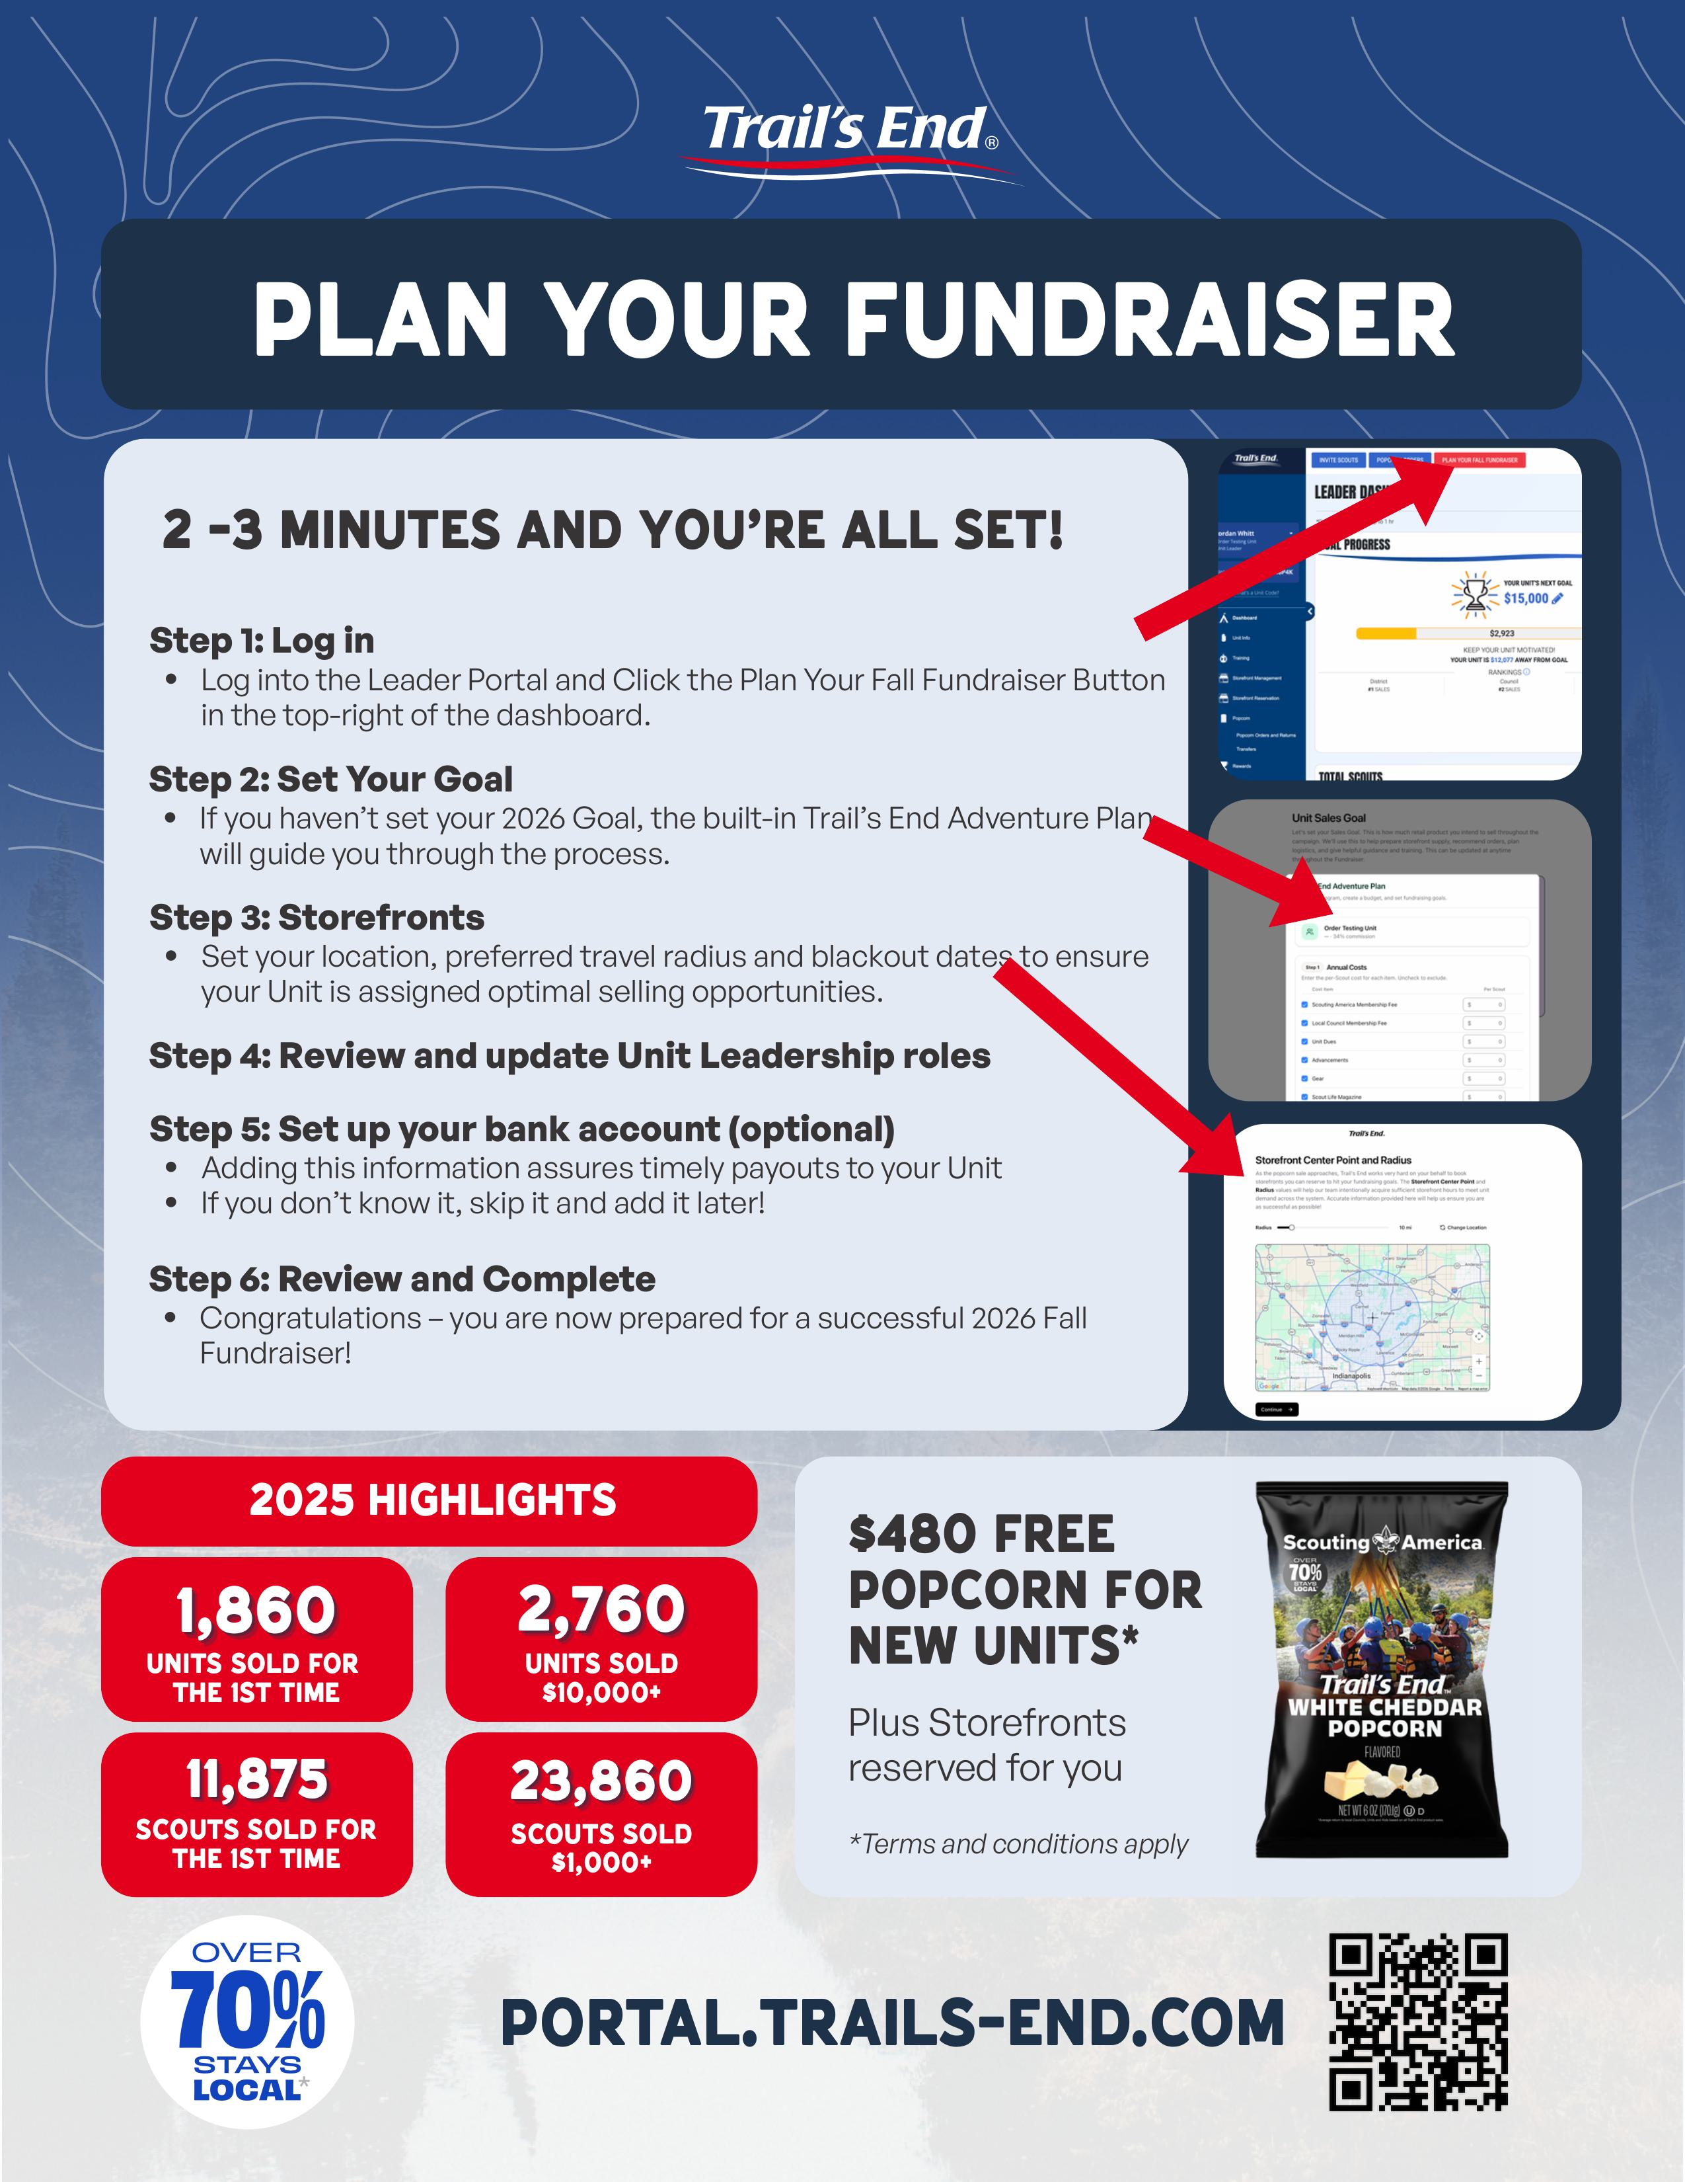
2026 Commitment and Onboarding
Attend a Kickoff
Commitment
Onboarding
Onboarding
Log In
Set Your Goal
Storefronts
Review and Update Unit Leadership Roles
Set up your bank account
Review and Complete
Group Discussion on why Committing and Onboarding is important.

Slide 25
Garden State Council Support
GSC Popcorn Kernel – Jerry Bakanowsky
Email – jvbakan@gmail.com
Phone – 856-364-3300
GSC Popcorn Staff Advisor – Brian Domzalski
Email – Brian.Domzalski@scouting.org
Phone – 609-261-5850 x229
Join the GSC Popcorn Facebook Group!
Garden State Council Scout Popcorn Campaign
Crossroads District Executive – Liam Millar
Email – Liam.Millar@scouting.org
Phone – 609-261-5850 x130
Osprey District Director – Javier Juarez
Email – Javier.Juarez@scouting.org
Phone – 609-261-5850 x132
Pine Hill District Executive – Omar Colon
Email – Omar.Colon@scouting.org
Phone – 609-261-5850 x214
Pinelands District Executive – Priscilla Borges
Email – Priscilla.Borges@scouting.org
Phone – 609-261-5850 x220

Slide 26
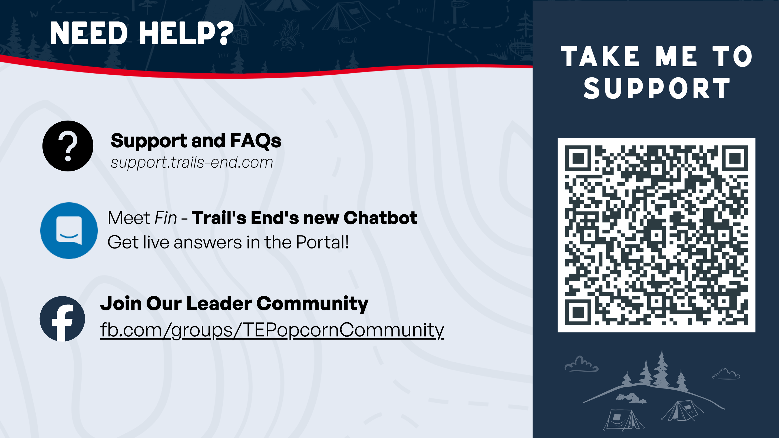

Slide 27


